Slide 1
[
]
WEBCENTER PRO PROGRAM
A SYSTEM FOR YOUR SUCCESS

Slide 2
BUSINESS OPPORTUNITY
HOW MANY SMALL BUSINESSES ARE IN THE USA?
27 MILLION
HOW MANY HAVE WEBSITES?
46%
HOW MANY ARE MOBILE?
44%
Notes:
TRAINER’S NOTES:
Briefly cover the market opportunity
Do not go into depth, just cover the information on the slide

Slide 3
THE MARKETPLACE
54% don’t have a website at all
And almost half of those who do,
don’t have a responsive website
100%
need simplicity, efficiency & value
Notes:
TRAINER’S NOTES:
Self explanatory

Slide 4
The average person spends 5.2 hours per day on their mobile device
74% of people are more likely to visit mobile-optimized sites
INTERNET CLIMATE
85% of customers expect businesses to be active on social media
There are 3.4 billion Google searches per day. 61% are for local searches
88% of consumers read online reviews to determine the quality of a local business
Notes:
TRAINER’S NOTES:
Here are some talking points:
We are all consumers of websites in our every day lives. Think about where you read your news, socialize etc.
Would you agree that people are plugged in and get much of their information online?
Businesses need to be online so they can interact with their customers and potential customers
Customers have an expectation to be able to browse websites for products, information and services

Slide 5
THERE ARE MULTIPLE WAYS
TO ARRIVE AT A DESTINATION
Notes:
Give examples:
Point to your name badge
Hiking Trails
Shuffle a deck of cards
Hit Director
They all have key things in common that must be applied – people need to find their groove to apply those things to get where they need to be

Slide 6
BIG BOX STORES
DESTINATION: INCREASE SALES, DECREASE EXPENSES
ROAD MAP:
MASS MARKETING
EXCELLENT WEBSITE & MOBILE PRESENCE
SEO
GOOGLE (SEM)
SOCIAL MEDIA & ONLINE CAMPAIGNS
CHALLENGE: BUILD CUSTOMER RELATIONSHIP
Notes:
TRAINER’S NOTES:
Self explanatory

Slide 7
LOCAL BUSINESSES
DESTINATION: INCREASE SALES, DECREASE EXPENSES
ROAD MAP:
CUSTOMER RELATIONSHIP
BASIC ADVERTISING / WEBSITE
CHALLENGE: MASSIVE GAP IN ADVERTISING BUDGET AND RESOURCES
Notes:
TRAINER’S NOTES:
Self explanatory

Slide 8
1990
TODAY
BEFORE SMB
WEBSITE
MOBILE
SEO
SOCIAL MEDIA
SEM
BLOG & CONTENT
REVIEW SITES
NEWSPAPER / YELLOW PAGES
WORD OF MOUTH
RUN BUSINESS
RUN BUSINESS
YELLOW PAGES
NEWSPAPER
WORD OF MOUTH

Slide 9
SIMPLICITY. SYNERGY. ACCESSIBILITY
Website I Maintenance I Social Media I Digital Marketing I Options
Notes:
TRAINER’S NOTES:
Transition slide

Slide 10
A COMPREHENSIVE DIGITAL STRATEGY
ONLINE SOLUTIONS
MERCHANT SERVICES
CUSTOMERS
WEBSITES
ECOMMERCE
GOOGLE
SOCIAL MEDIA
CONTENT
COMMUNICATION
CREDIT CARD FEES
REDUCE FEES
CARD SWIPER
SHOP.COM PARTNER
SHOP LOCAL
PREFERRED CUSTOMER PROGRAM
Notes:
TRAINER’S NOTES:
We offer Online Solutions, such as…..
We offer Merchant Services, such as…
And we offer clients the ability to become Shop.com Partners, ShopLocal customers, or Preferred Customers to save money on business expenses.

Slide 11
What Makes Us Different
Our clients are getting more than just a website, they are getting an entire online marketing strategy.
Let’s take a look at the myriad of tools and options that our clients have.
Notes:
TRAINER’S NOTES:
Introduce the concept of online marketing strategy verses just a website

Slide 12
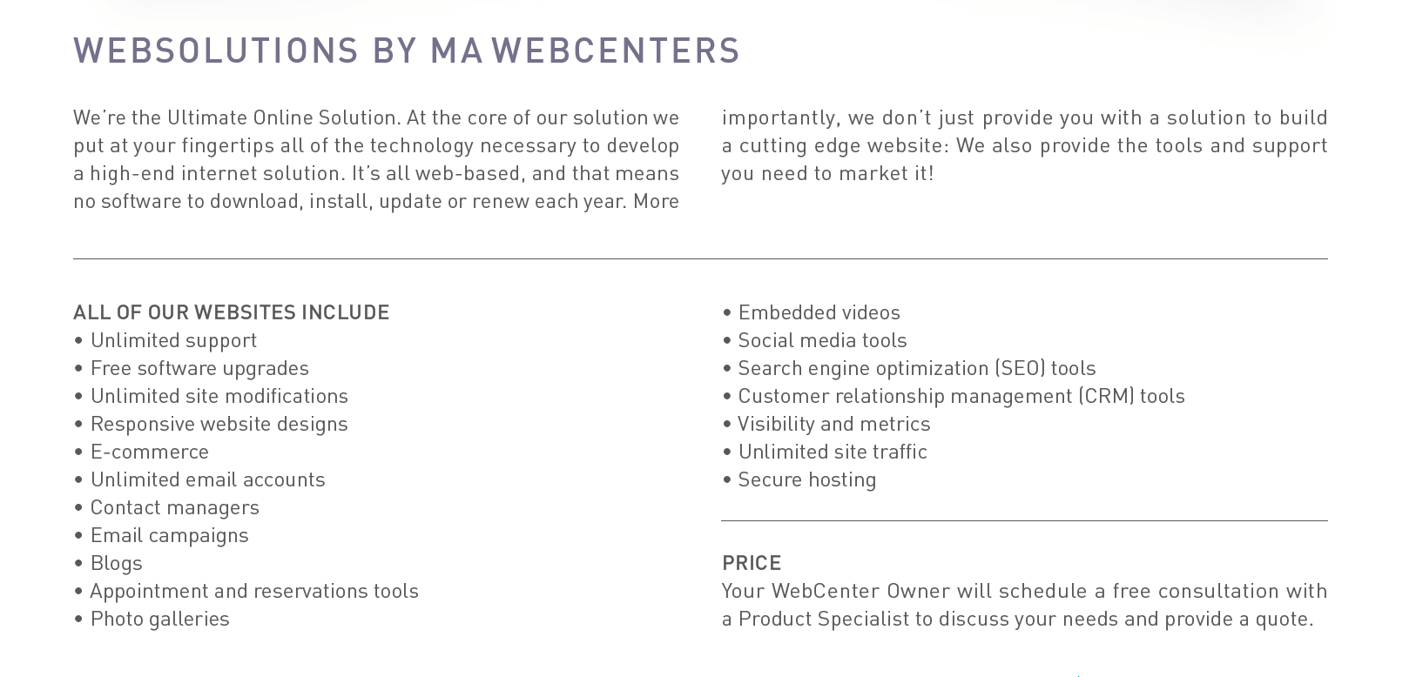
MORE THAN JUST A WEBSITE
Notes:
Trainers Notes:
This is just an intro slide – The goal here is to get them excited about what we are going to talk about.
In brief, cover the big topics “Websites, Marketing Tools, Unlimited, Support, Security)
The goal is to paint a simple picture of how all –inclusive our solution actually is / Instill confidence in the product.
Spend 1 minute or less on this slide – the details are coming up!

Slide 13
eCommerce Tools
Configurable product options that adjust the sales price
Shopper wish list
Pan and zoom product image
Compare products
Order history with easy “Reorder” feature
Multiple billing options
Shopper product reviews
Product tags
Sales dashboard
See who’s shopping
Enhanced Product Catalog search results with product thumbnails
Notes:
TRAINER’S NOTES:
Our e-commerce system is incredibly flexible.
There is so much which can be done with it.
(share some personal examples from your own client base).
(hit some of the highlights from the Features & Benefits).
Again, this is about providing an effective Internet presence. If the business owner’s current solution doesn’t allow for customer reviews or wish lists, is it an effective internet presence? Nope!
No transaction fees!

Slide 14
The Power of Unlimited
Unlimited Pages
Unlimited Changes
Unlimited Traffic
Unlimited E-mail Address
Unlimited Web Content Storage
Unlimited support, changes and upgrades.
We take away the challenges that business owners face to stay current with their online marketing solution.
Notes:
Trainers Notes:
Self Explanatory

Slide 15
AWARD-WINNING,
UNLIMITED CUSTOMER CARE
Unlimited help editing the site
Support using all features & tools in our solution
Home country, 24/7 support
Ultra-secure hosting facility 24x7 Security and incident monitoring, hosted on tiered, high performance Dell PowerEdge servers, protected from fire, floods, earthquakes, power outages, and other types of disasters
Dual-layer firewall protection Using Cisco PIX firewalls
Notes:
Trainers Notes:
Share Stories!

Slide 16
WEB MANAGEMENT
BASIC MONTHLY MEMBERSHIP
Includes hosting, CMS, live chat. (no ecommerce, CRM, email marketing or voice support)
MONTHLY MEMBERSHIP
Includes hosting, emails, unlimited technical support editing their website and using the marketing tools and unlimited upgrades to the platform.
MANAGED MONTHLY MEMBERSHIP
Includes everything that comes in monthly membership plus up to 10 hours/month of editing and content management. Free premium responsive layout every year.
LISTEN:
Do you or clients want to save time or money?
Do your clients have the resources to manage their own site?
Notes:
TRAINER’S NOTES:
MOST IMPORTANT: “LISTEN FOR” So you can offer a solution to the problem
You can use the B2B Catalog (pictured on the right) to educate a client on how we compare and what we offer with our core solution
Product Specialists can answer further questions on this during an appointment
There are FAQs on mawc411.com and mawebcenters.com

Slide 17
DESIGN OPTIONS
DESIGN CENTER
Clients have a variety of options for getting their website designed. The layout of the website along with your site’s content are critical to help you establish an effective Internet presence.
All of our design packages are designed inside the editable maWebCenters platform so you have the flexibility to maintain your content or add more pages in the future.
WebCenter Professionals can store previously designed layouts for future use.
LISTEN:
Do you want to design sites yourself?
Would you prefer we design?
Notes:
TRAINER’S NOTES:
MOST IMPORTANT: “LISTEN FOR” So you can offer a solution to the problem
You can use the B2B Catalog (pictured on the right) to educate a client on how we compare and what we offer with our core solution
Product Specialists can answer further questions on this during an appointment
There are FAQs on mawc411.com and mawebcenters.com

Slide 18
DESIGN CENTER

Slide 19
DESIGN CENTER

Slide 20
DESIGN CENTER

Slide 21
DESIGN CENTER

Slide 22
DIGITAL MARKETING:
Marketing your business through digital channels.
OPTION 1: TECH SUPPORT Website Clients have unlimited access to Tech Support
OPTION 2: SERVICES
Purchase Digital Marketing Products.(Can be purchased by existing clients or non-website clients)

Slide 23
COMMUNICATION
EMAIL MARKETING
As part of the website platform, there is a customer database tool that also allows website clients to create email newsletters, campaigns, as well as access to email statistics.
TEXT MESSAGE MARKETING
Morse Connect is a robust text marketing product that enables a landline or Toll-Free number to receive text messages. The service also allows for text promotional campaigns, individual responses, as well as autoresponders based on keyword and keyword phrases to streamline business communication and increase customer/client engagement
CHALLENGE:
How are you communicating with clients?
Could they use increased engagement?
Do they need to improve client communication
Are they leveraging text message marketing?
Notes:
TRAINER’S NOTES:
MOST IMPORTANT: “LISTEN FOR” So you can offer a solution to the problem
You can use the B2B Catalog (pictured on the right) to educate a client on how we compare and what we offer with our core solution
Product Specialists can answer further questions on this during an appointment
There are FAQs on mawc411.com and mawebcenters.com

Slide 24
SEO
LOCAL AND REGIONAL SEO
Search Engine Optimization, ensures your business ranks high on search engines like Google and Yahoo when a consumer is looking for a specific product or service.
We’ll discuss your desired goals related to your website, the geographic areas you wish to reach, and the demographics of your desired customer. We conduct SEO tasks related to site keywords, page titles, headings, page descriptions, and many more ways to make you stand out from the crowd.
CHALLENGE:
Is their site showing up in Search?
Are they ranking against their competition?
Are there new products and services they want to be found for?
Notes:
TRAINER’S NOTES:
MOST IMPORTANT: “LISTEN FOR” So you can offer a solution to the problem
You can use the B2B Catalog (pictured on the right) to educate a client on how we compare and what we offer with our core solution
Product Specialists can answer further questions on this during an appointment
There are FAQs on mawc411.com and mawebcenters.com

Slide 25
GOOGLE ADWORDS
GOOGLE ADWORDS
Search engine giant Google offers its paid AdWords service to businesses who wish to enhance their Internet marketing efforts.
Our SEO specialists will guide you through the AdWords process, taking care of subjects like account creation, campaigns, budgets, networks, mobile device targeting, geographical targeting and much much more.
CHALLENGE:
Who manages their Adwords?
Do they need quick results?
Do they have a great site but just need help marketing it?
Notes:
TRAINER’S NOTES:
MOST IMPORTANT: “LISTEN FOR” So you can offer a solution to the problem
You can use the B2B Catalog (pictured on the right) to educate a client on how we compare and what we offer with our core solution
Product Specialists can answer further questions on this during an appointment
There are FAQs on mawc411.com and mawebcenters.com

Slide 26
SOCIAL MEDIA
SOCIAL MEDIA MANAGEMENT
We offer a smooth, results-driven package in which our specialists will create profiles on the social media sites of your choice, post written and image-driven content each week, and respond to comments or questions that might arise on these highly viewed services.
ONLINE REPUTATION MANAGEMENT
Our online reputation management services include a monthly scan of the online world for negative reviews, and clear reporting of activity on consumer review sites that could affect your revenue, profits and foot traffic.
CHALLENGE:
Are they leveraging Social Media?
Are the consistent with posting & responding?
Do they monitor online reviews?
Who manages their online listings?
Notes:
TRAINER’S NOTES:
MOST IMPORTANT: “LISTEN FOR” So you can offer a solution to the problem
You can use the B2B Catalog (pictured on the right) to educate a client on how we compare and what we offer with our core solution
Product Specialists can answer further questions on this during an appointment
There are FAQs on mawc411.com and mawebcenters.com

Slide 27
FACEBOOK ADS
FACEBOOK ADVERTISING
Billions of people are on Facebook, so you can be sure that we’ll find you an audience.
We’ll discuss with you your target market demographics, the geographic area you wish to reach, and all other vital details to get your campaign kicked off.
Expect a monthly consultation and report detailing exactly where your hard earned marketing dollars are going.
CHALLENGE:
Are your clients on Facebook?
Could they use increased exposure?
Do they need to grow engagement on their business Facebook page?
Are they leveraging Facebook Ads?
Notes:
TRAINER’S NOTES:
MOST IMPORTANT: “LISTEN FOR” So you can offer a solution to the problem
You can use the B2B Catalog (pictured on the right) to educate a client on how we compare and what we offer with our core solution
Product Specialists can answer further questions on this during an appointment
There are FAQs on mawc411.com and mawebcenters.com

Slide 28
REFERRAL MARKETING
SHOP LOCAL
Drive more foot traffic to your physical business.
SHOP.COM PARTNER STORE
Drive traffic to your website via our over 3 million loyal customers and 200,000 UFO websites.
APN (AFFILIATE PUBLISHER NETWORK)
Publish relevant SHOP Products right to your site and earn commission for referring the sale.
CHALLENGE:
Are they looking for more “in store traffic”?
Are they looking for more online traffic?
Are they looking for an additional stream of income?
Notes:
TRAINER’S NOTES:
MOST IMPORTANT: “LISTEN FOR” So you can offer a solution to the problem
You can use the B2B Catalog (pictured on the right) to educate a client on how we compare and what we offer with our core solution
Product Specialists can answer further questions on this during an appointment
There are FAQs on mawc411.com and mawebcenters.com

Slide 29
WEBCENTER PRO PROGRAM: WEBCENTER-PRO.COM
LINE OF PRODUCTS
TEAMS OF PROFESSIONALS
CO-BRANDED ADMIN & INVOICING
FULLY CUSTOMIZABLE FRONT END SITE
VIP SUPPORT
PROFESSIONAL EDUCATION

Slide 30
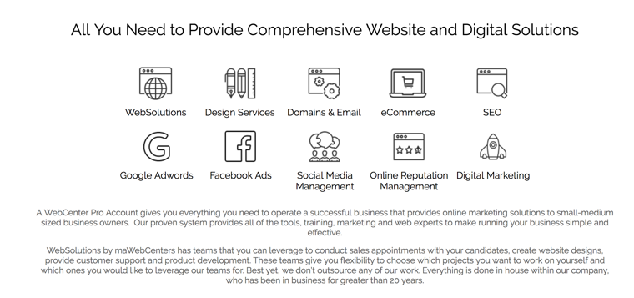
DIGITAL PRODUCTS: EXPAND YOUR OFFERING

Slide 31
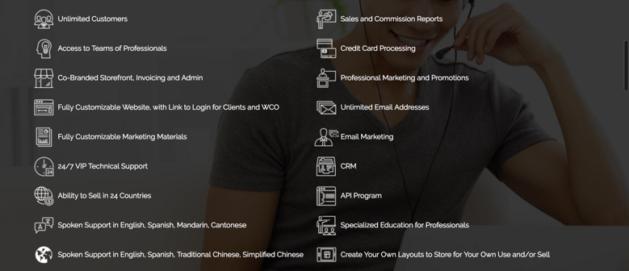
PRO PROGRAM BENEFITS

Slide 32
PRO EDUCATION

Slide 33
WEBCENTER PRO &THE UNFRANCHISE® BUSINESS
CLIENTS EARN CASHBACK
YOU EARN RETAIL PROFITS
YOU EARN ONGOING INCOME
CLIENTS EARN CASHBACK FROM THEIR ONLINE PURCHASES FOR BUSINESS EXPENSES ON YOUR SHOP.COM
EARN GROSS RETAIL PROFITS FROM WEBSITES AND DIGITAL MARKETING PRODUCTS THAT YOU SELL.
MANY DMP PRODUCTS ALSO GENERATE MONTHLY RETAIL PROFITS
PRO AFFILIATES: Earn $300 -$1,500/week from BV generated as a result of your sales and your organization
PRO PARTNERS: Earn $300 - $3,600/ week per BDC from BV and IBV generated as a result of your sales and your organization with unlimited earning potential through multiple BDC’s
†EARN 30-50% GROSS RETAIL PROFIT ON MOST PRODUCTS, WHEN SOLD AT SUGGESTED RETAIL PRICE. EARN UP TO 1000% GROSS RETAIL PROFIT ON THE SALE OF WEBSITES.
*THE INCOME LEVELS MENTIONED IN THE FOLLOWING PRESENTATION ARE FOR ILLUSTRATION PURPOSES ONLY. THEY ARE NOT INTENDED TO REPRESENT THE INCOME OF A TYPICAL MARKET AMERICA UNFRANCHISE OWNER, NOR ARE THEY INTENDED TO REPRESENT THAT ANY GIVEN UNFRANCHISE OWNER WILL EARN INCOME IN THAT AMOUNT. THE SUCCESS OF ANY MARKET AMERICA UNFRANCHISE OWNER WILL DEPEND UPON THE AMOUNT OF HARD WORK, TALENT, AND DEDICATION WHICH HE OR SHE DEVOTES TO BUILDING HIS OR HER MARKET AMERICA BUSINESS.

Slide 34
GET PAID TO SHOP
NEVER MISS A DEAL
SHOP.COM PARTNER STORES CARRY CASHBACK AND IBV (POINTS)
YOUR CUSTOMERS EARN CASHBACK
YOU EARN IBV ON YOUR ONLINE PURCHASES AND THEIRS*
*WebCenter Pro Partners

Slide 35
Let’s take a look at earning potential
Retail Profit
BV
Growth Potential
Notes:
TRAINER’S NOTES:
Earning potential will be demonstrated in terms of short term and long term growth potential

Slide 36
RETAIL PROFITS WHOLESALE PRICES: WWW.MAWC411.COM
AVERAGE RETAIL PROFIT FOR A WEBSITE SALE IS $1,000
DIGITAL & SOCIAL PRODUCE AUTOMATIC MONTHLY RETAIL PROFIT

Slide 37
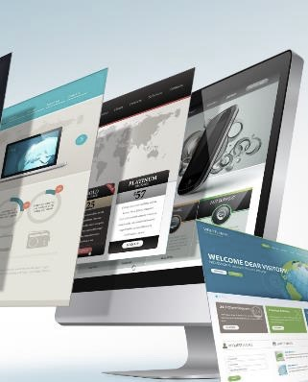
Each website sold
Generates at least 230 BV
Each active client
generates
5, 30 or 35 BV / Mo.
DIGITAL MARKETING PRODUCTS GENERATE ADDITIONAL BV AND RETAIL PROFITS
Notes:
TRAINER’S NOTES:
Long Term Potential for WCOS = Ongoing BV and Retail Profits
Describe Business Volume as a unit point value attached to each product and service based on profit margin which will accumulate to pay out additional commissions on Gross Business (Sales) Volume.

Slide 38
Build share of customer
Your client buys a website
ITEM | RETAIL PROFIT | BV
WEBSITE SALE | $1,000 | 200 BV 30/ MO.
SOCIAL MEDIA MANAGEMENT | $15/ MO. | 20 BV/ MO.
PREMIUM FACEBOOK ADVERTISING | $10/ MO. | 15 BV/ MO.
BASIC GOOGLE ADVERTISING | $24/ MO. | 24 BV/ MO.
TOTAL INITIAL SALE | $1,000 | 289 BV
TOTAL RECURRING | $49/ MO. | 89 BV/ MO.
AND wants to market the site
YOU CAN START WITH A WEBSITE SALE OR A DIGITAL MARKETING PRODUCT SALE
GROW THE RELATIONSHIP TO BUILD SHARE OF CUSTOMER
Notes:
TRAINER’S NOTES:
Take a look at what the Digital Marketing Products generate
Remember, full pricing and BV is available on mawc411.com/support.html

Slide 39
Australia
Bahamas
Bermuda
Canada
Chile
China
Columbia
Costa Rica
Dominican Republic
Ecuador
Hong Kong
Indonesia
Ireland
Jamaica
Macau SAR China
New Zealand
Panama
Philippines
Singapore
Spain
Taiwan
United Kingdom
United States
YOUR GLOBAL WEBCENTER
Your WebCenter is automatically enabled to sell websites globally in all Market Countries & EMP Countries. You earn Home Country Retail Profit & BV!
Notes:
TRAINER’S NOTES:
What does that do for us?
First, by having websites which are completely in other languages and the entire back end of the system, including the menus and contextual help, the business owners who are more comfortable with another language will be able to take more effective use of the solution.
Second, by providing all the support, from sales to ongoing support with clients, all in multi-languages.
As a non-native speaker, you can probably find numerous business owners who you can have a short conversation to set an appointment with, but you wouldn’t be able to do a sales walkthrough because the business owner might not understand English well enough. This way, all you need to do is set the appointment, and let the team handle the rest for you!
And we all know that some of your best business prospects are business owners and customers of yours. This is a very natural way to lead to prospects for the business in a cultural market you might not have thought you could make inroads to.

Slide 40
PRO AFFILIATE
FULL ACCESS TO THE PRO PROGRAM &
LIGHT ACCESS TO THE UNFRANCHISE BUSINESS
Earn up to $1,500/ Week in BV commissions
BV commission is capped at $78,000/year
Cannot sponsor or expand your organization
Cannot receive BV placed from senior business partners
Cannot place BV in personally sponsored
Does not count as “activation” for Senior Partners
Does count for Senior Partner bonuses

Slide 41
PRO PARTNER
FULL ACCESS TO THE PRO PROGRAM &
FULL ACCESS TO THE UNFRANCHISE BUSINESS
Earn up to $2,100/ Week in BV commissions
Earn up to $1,500/ Week in IBV commissions
Unlimited Earning Potential for BV/IBV commissions
Can sponsor and expand your organization
Can receive BV placed from senior business partners
Can place BV in personally sponsored
Does count as “activation” for Senior Partners
Does count for Senior Partner bonuses

Slide 42
CREATE AN ONGOING INCOME with BV & IBV
COMMISSIONS
WEBCENTER PROS ARE PART OF A DISTRIBUTION ORGANIZATION THAT GENERATES GROUP BUSINESS VOLUME (BV & IBV)
*GRAY INDICATES PERSONALLY SPONSORED UNFRANCHISE® OWNER
Notes:
Describe the Network in terms of referral alliances of businesses they may already collaborate with. Graphic Designers, SEO firms, Ad agencies, Web Developers, Stay at home freelancers, Traditional business owners

Slide 43
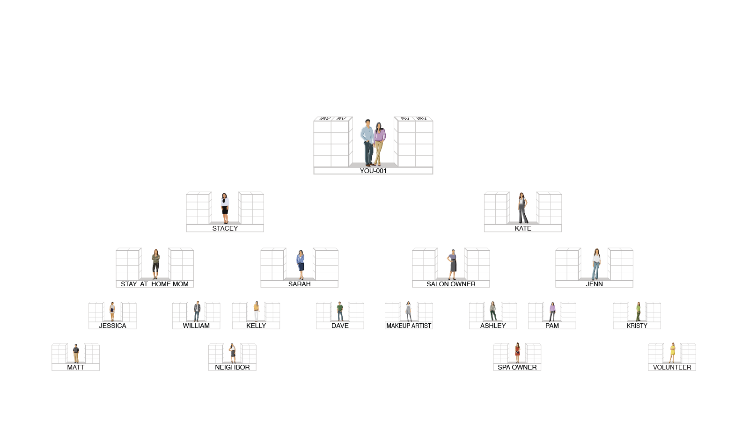
OUR TRACKING SYSTEM SEARCHES DAILY TO INFINITY
THE SYSTEM TRACKS PURCHASES AND SALES MADE BY YOU, YOUR CUSTOMERS AND YOUR TEAM. YOU RECEIVE 100% CREDIT FOR ALL VOLUME GENERATED WITHIN YOUR ORGANIZATION

Slide 44
DISCLAIMER
THE INCOME LEVELS MENTIONED IN THE FOLLOWING PRESENTATION ARE FOR ILLUSTRATION PURPOSES ONLY. THEY ARE NOT INTENDED TO REPRESENT THE INCOME OF A TYPICAL MARKET AMERICA UNFRANCHISE® OWNER, NOR ARE THEY INTENDED TO REPRESENT THAT ANY GIVEN UNFRANCHISE OWNER WILL EARN INCOME IN THAT AMOUNT. THE SUCCESS OF ANY MARKET AMERICA UNFRANCHISE OWNER WILL DEPEND UPON THE AMOUNT OF HARD WORK, TALENT AND DEDICATION WHICH HE OR SHE DEVOTES TO BUILDING HIS OR HER MARKET AMERICA BUSINESS.

Slide 45
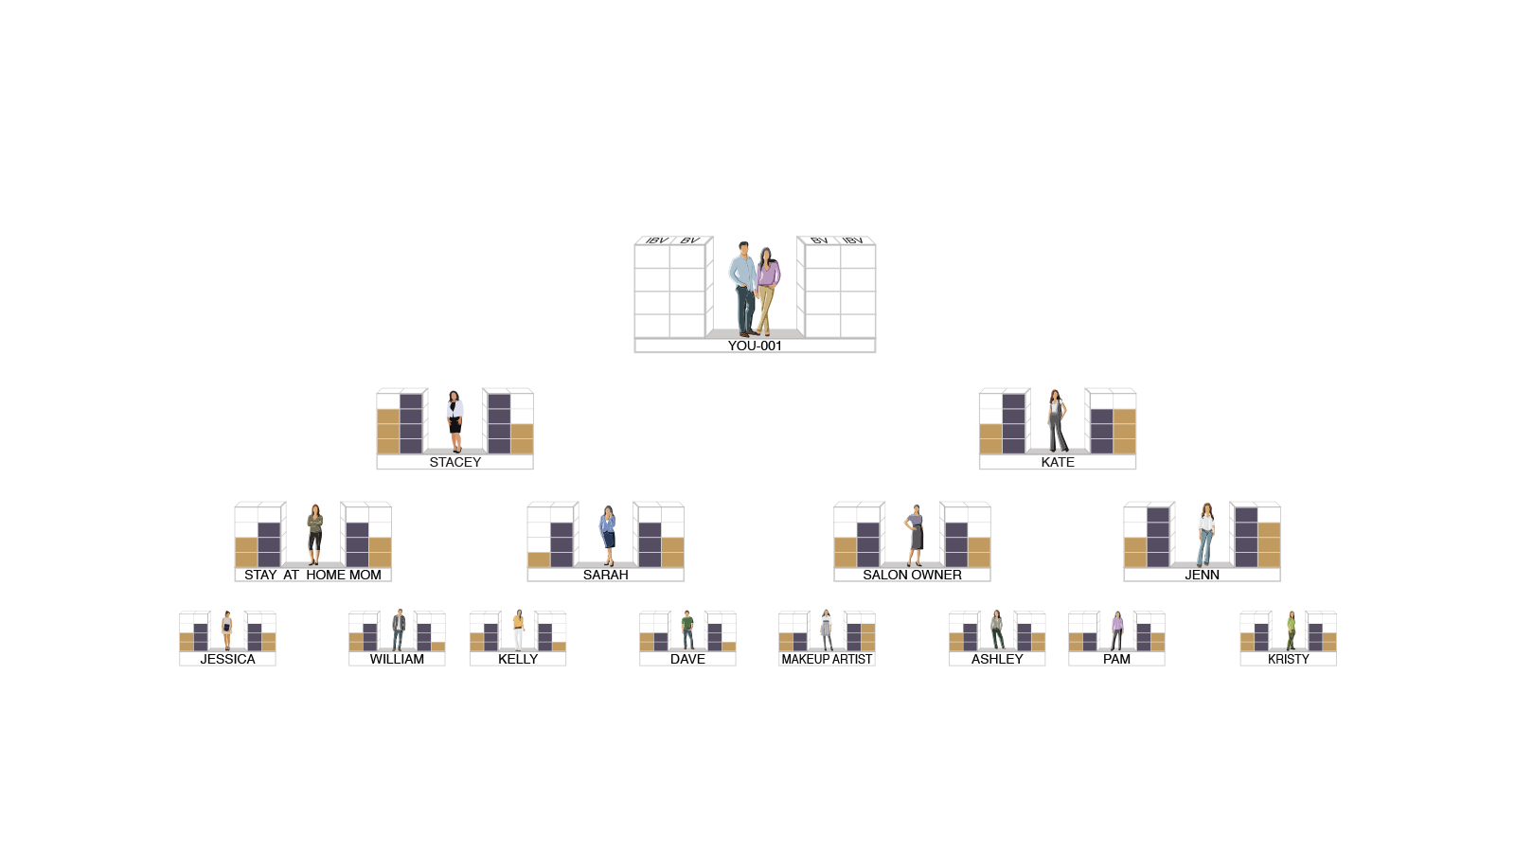
HOW COMMISSIONS ARE EARNED
BV AND IBV ARE TRACKED DAILY AND COMMISSIONS ARE CALCULATED WEEKLY
5000 / 5000 = $600
3600 / 3600 = $300
2400 / 2400 = $300
1200 / 1200 = $300
$1,500
5000 / 5000 = $600
3600 / 3600 = $300
2400 / 2400 = $300
1200 / 1200 = $300
$1,500
BV
5000
5000
IBV
3600
3600
2400
2400
1200
1200
TOTAL WEEKLY POTENTIAL $3,000 PER BDC
(PRO PARTNERS ARE ELIGIBLE FOR $600 BONUSES)

Slide 46
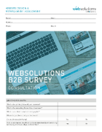
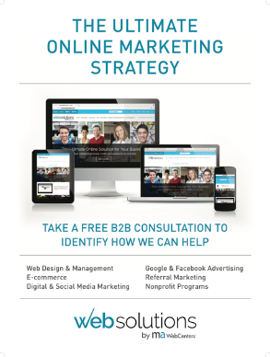
WHAT’S IN A PRO SUBSCRIPTION KIT?
PRO WEBCENTER
CUSTOMIZABLE WEBSITE MA WEBSITES
2 MONTHS UFMS *Pro Partners receive MA Subscription Kit as well
1-BUNDLE OF ASSESSMENT PADS
5-B2B SERVICES CATALOGS
5-RESOURCE MAGNETS
5-POSTERS
5-DECALS
*Additional Sales & Marketing tools available for purchase and Download.

Slide 47
WEBCENTER PRO OPTIONS
 | SALES REP (6073) OR NEW WC PRO AFFILIATE (1586) | SALES REP (1585) OR NEW WC PRO PARTNER (1574) | AFFILIATE UPGRADE TO PRO PARTNER (6080) | UFO UPGRADE TO PRO PARTNER (6072)
Pro WebCenter
Sales & Marketing Kit and MA Websites
UFMS
Market America Subscription Kit
Cost Associated BV | $239 100BV | $429 300BV | $199 100BV | $379 300BV
*All WebCenter Pro Accounts Monthly Fee: $79/ month and UFMS: $21.95/month

Slide 48
YOUR NEXT STEPS
CONTINUE YOUR RESEARCH Review www.mawc411.com Review www.mawebcenters.com
BOOK A FOLLOW-UP Schedule an appointment to get your questions answered and learn about the UnFranchise
ESTABLISH YOUR WEBCENTER PRO ACCOUNT Become a WebCenter Pro Affiliate or Pro Partner
Notes:
TRAINER’S NOTES:
Self explanatory

Slide 49
THANK YOU
WE LOOK FORWARD TO A SUCCESSFUL PARTNERSHIP

